Slide 1

Portfolio
Su Zhang

Slide 2

AGENDA
Decision making process
Navigation and Sitemap
Wireframes and components
Audience Engagement
Development/build process
Feature overview
Questions
Notes:
Hello everyone, I am Su, today I would like to talk about my portfolio website,
Here is the agenda for my presentation

Slide 3
Decision making process
Notes:
Decision making process

Slide 4
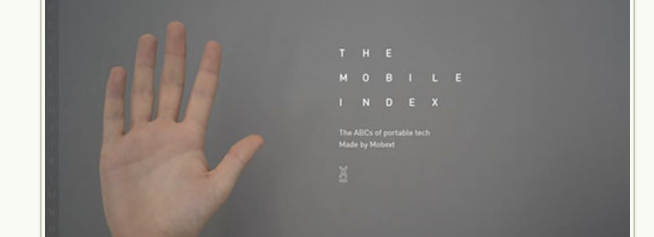
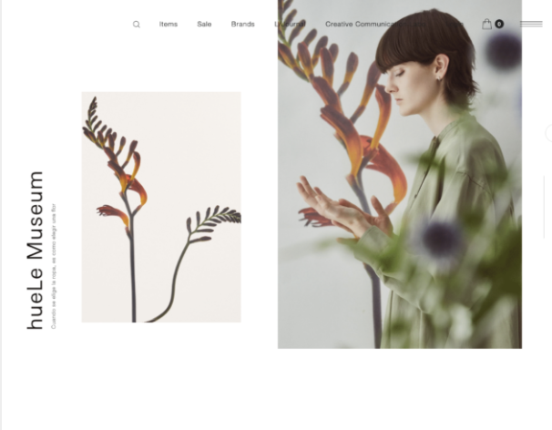
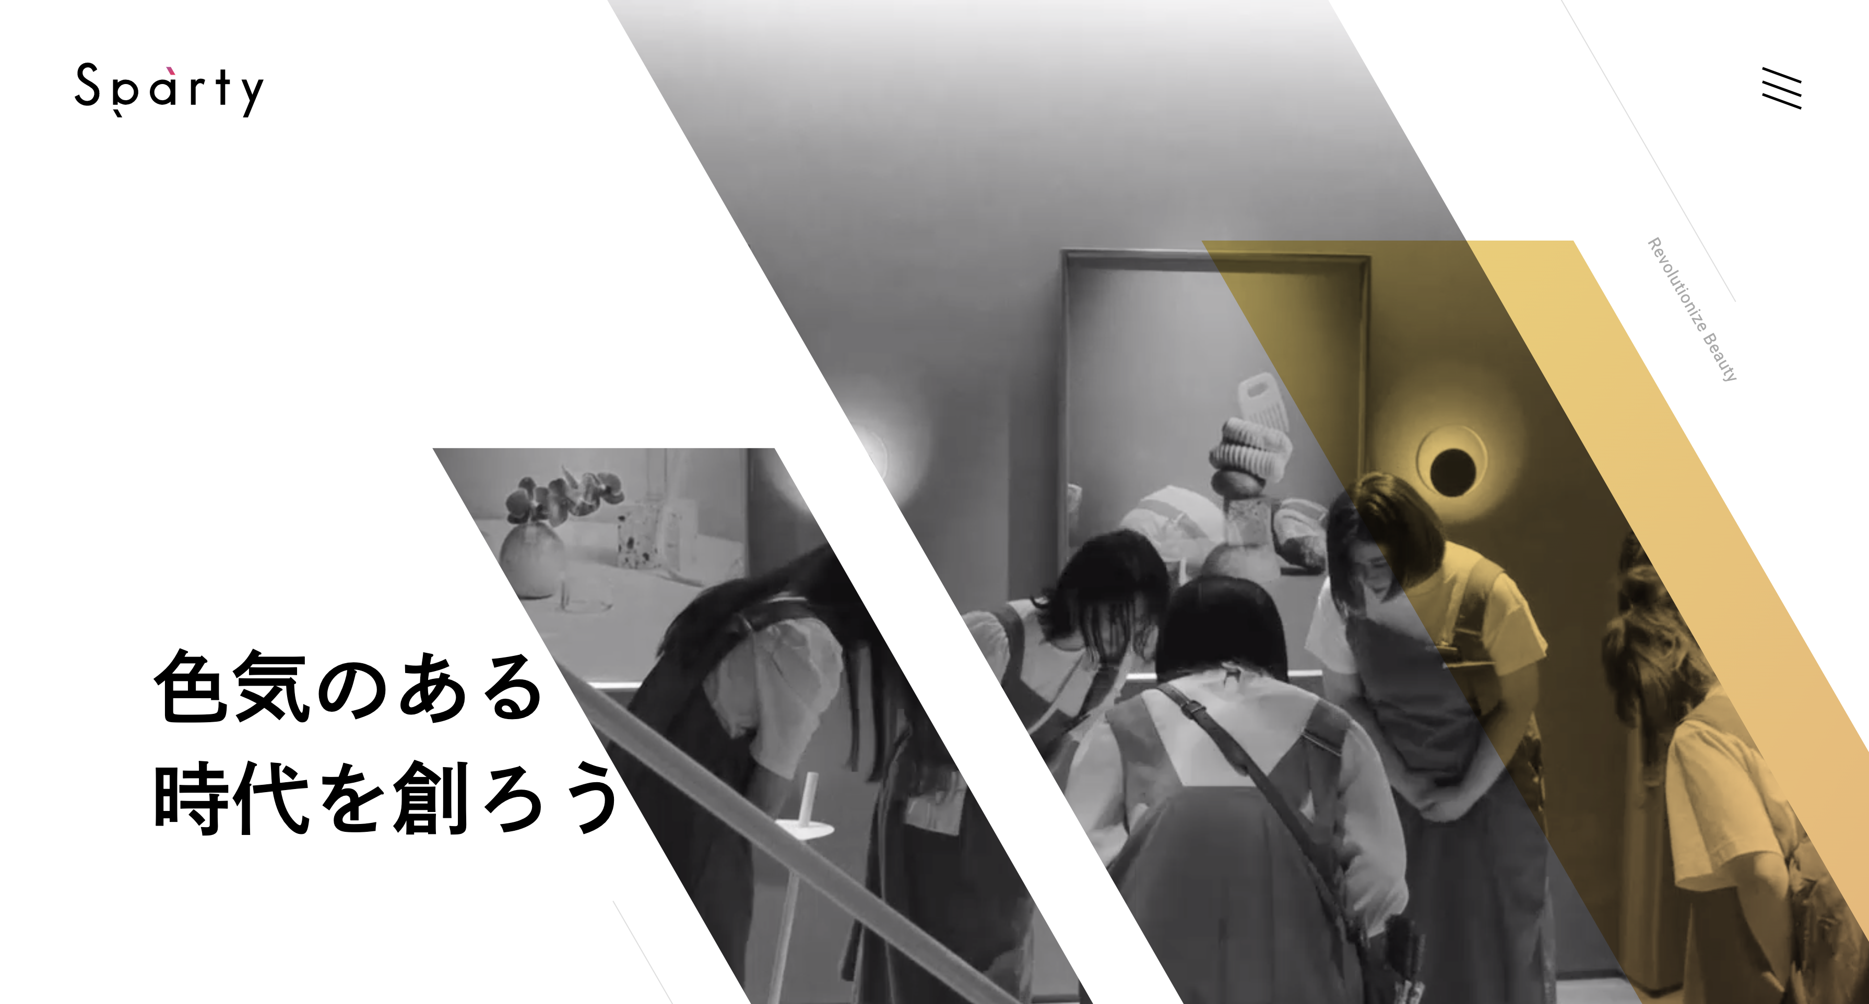
Inspirations
Minimalist white space style
Blank art
Notes:
Inspirations:
My design is inspired by the minimalist white space style of Japanese web
There are no unnecessary decorative elements in the layout, which makes the theme more focused

Slide 5
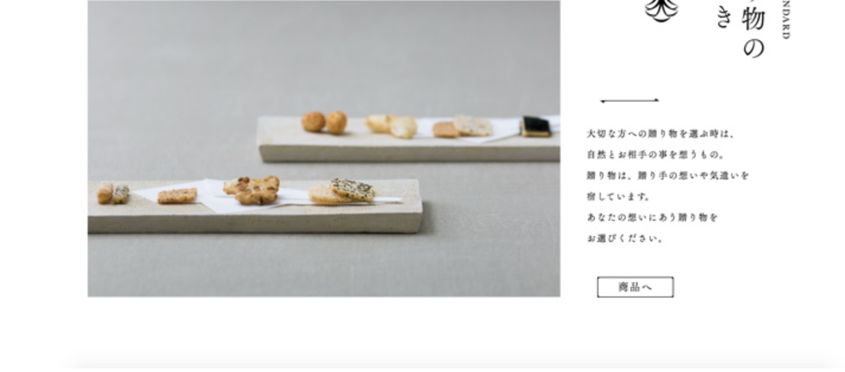
Decisions
Simple page design
Notes:
Decisions：
By choosing a simple page design, it allows me to put what I have learned so far into practice
The simple design is also highly extendable, paving the way for the additional design and animation effects in the future

Slide 6
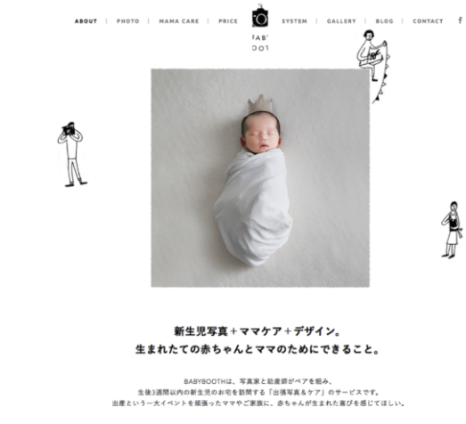
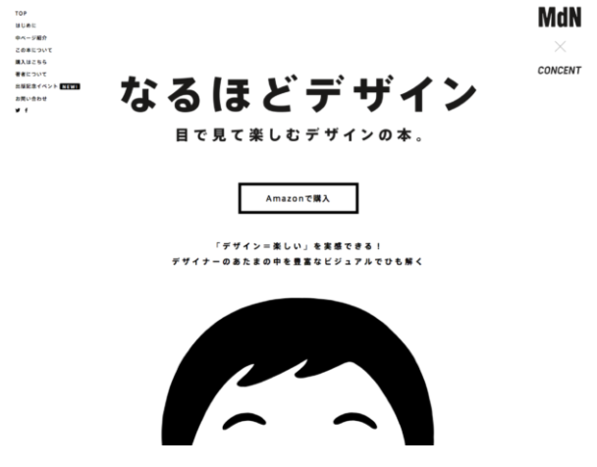
Design Aesthetic
Varying text and images
Complimentary colors
Notes:
Design overall aesthetic ：
I used multiple images and text on the same page but in different positions to reflect the sense of style and the fun to the viewer
In terms of colour selection, I chose two colours with low saturation this gives users a comfortable and peaceful feeling.

Slide 7
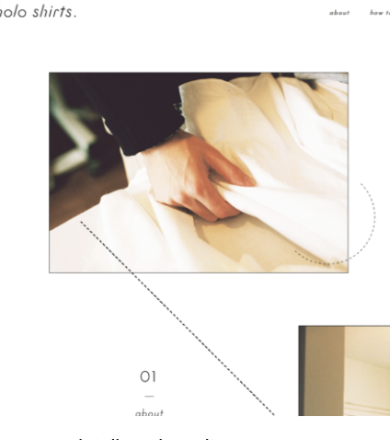
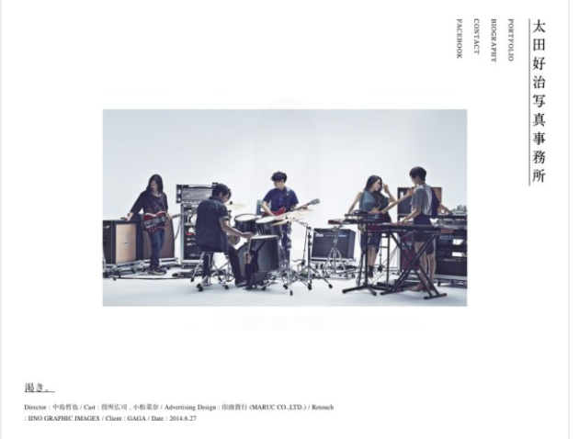
Process
Balsamiq → HTML and CSS → Styles → Functionality
Notes:
Process:
I started by using Balsamiq to create the wireframes for the overall design of the website layout
Next, I used the wireframes as a draft to write my CSS and HTML and transitioned the design into code
Finally, I selected the design style, colours, and images as well as adding functionality such as a hamburger menu, animations and extra details.

Slide 8
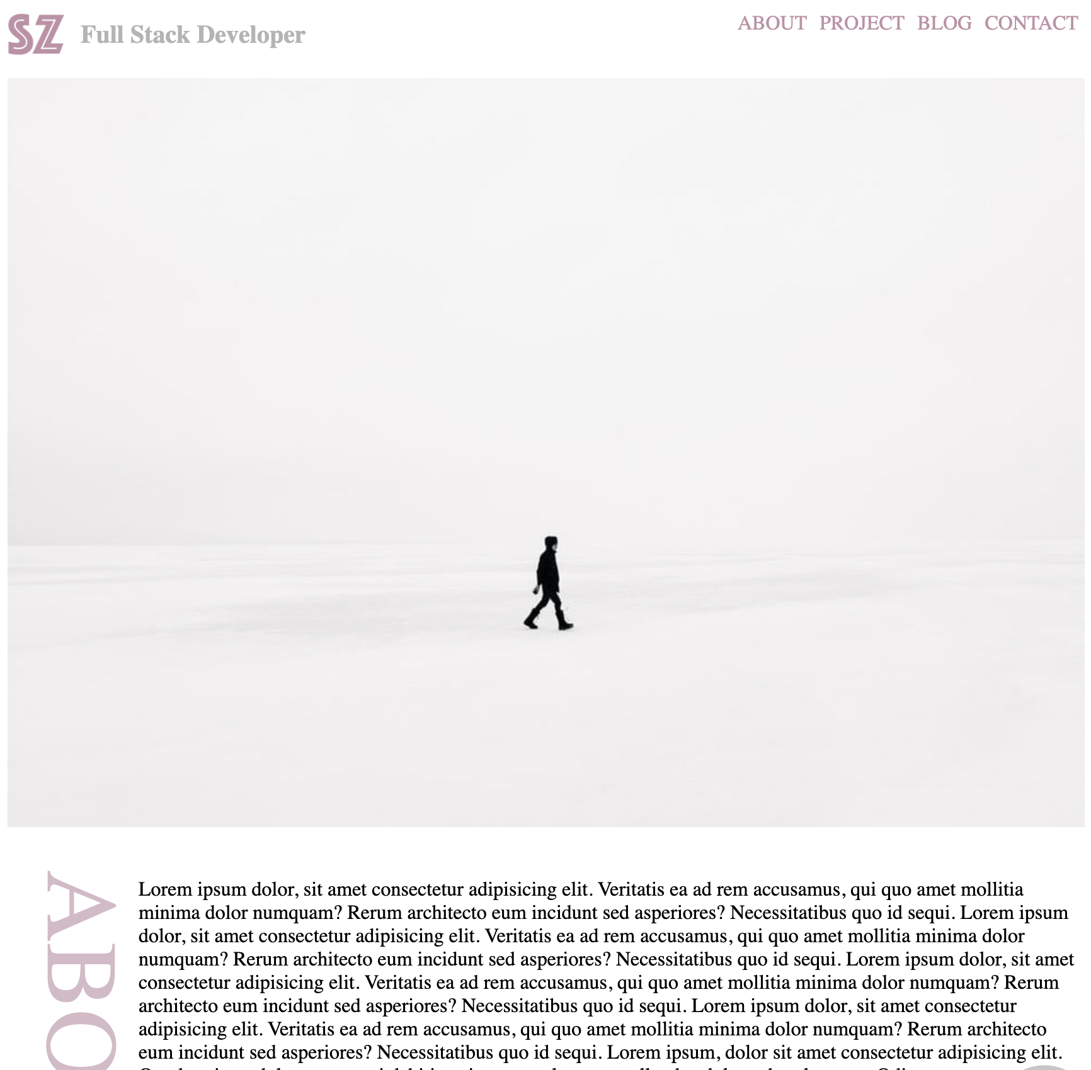
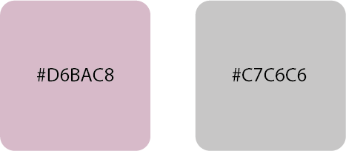
Color Palette
Light grey
Formal
Professional
Light pink
Feminine characteristics
Delicate
Pace and Quiet
Reflect the delicacy of women without losing professionalism
Notes:
The main colour of the website is light grey with pink
The two-colour combination fully balances personal character and professionalism. Conveying a sense of quiet and comfort to the user.

Slide 9
Images Source
https://unsplash.com/
Notes:
I am using un-splash as my image source

Slide 10
Navigation and Sitemap
Notes:
Navigation and sitemap

Slide 11
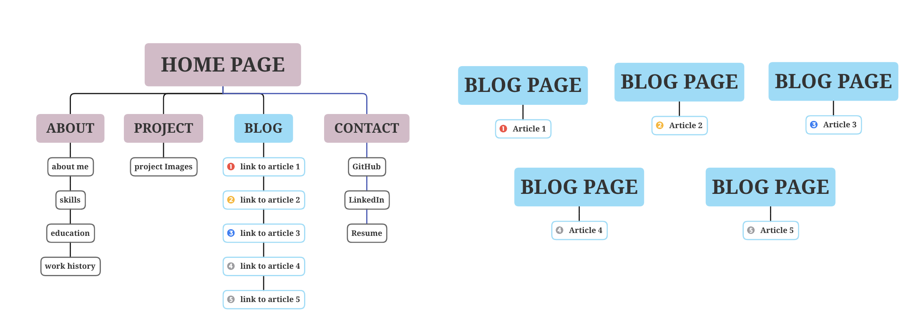
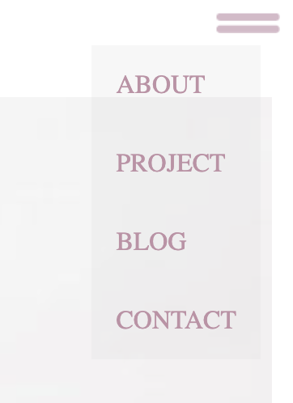
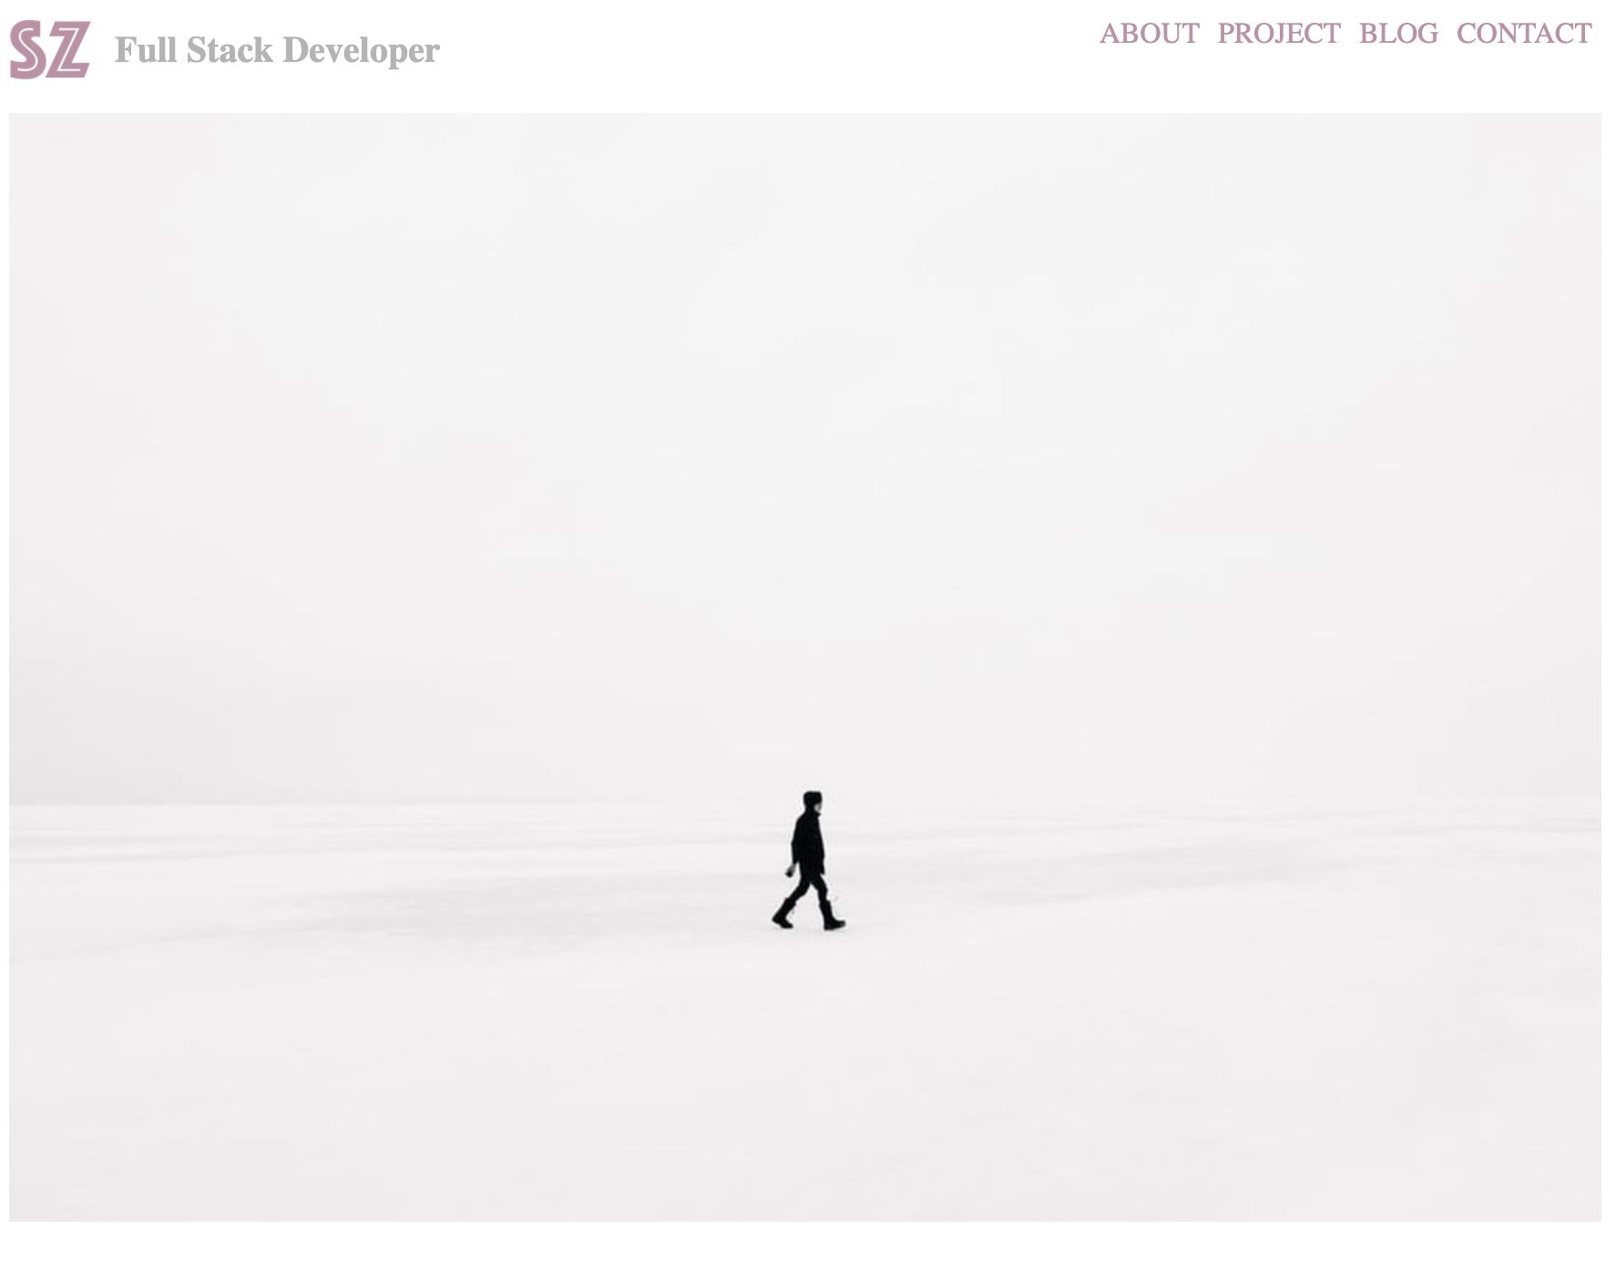
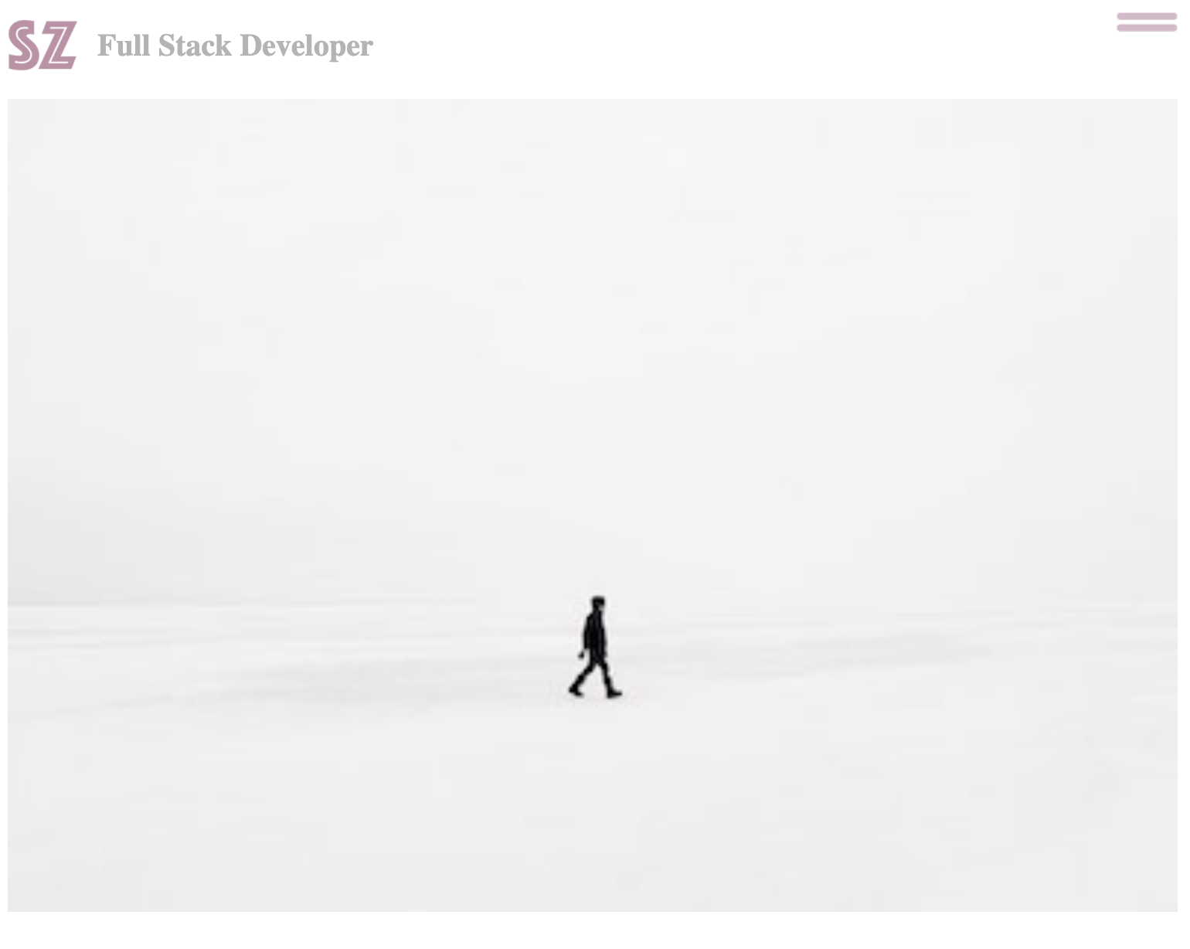

Logo
Navigation Bar
Hamburger menu
Back-to-top navigation
Notes:
structure :
The website is designed in a one-page format
The main page is divided into 4 sections, About, Project, Blog and Contact
Navigating to different pages :
The majority of the site is based on a single page.
In the home page area, the navigation bar can quickly navigate to different areas of the site
The logo is used as a quick return to the main page from anywhere in the site.
As this is a one-page design, the layout will be relatively long, so I designed the back-to-top navigation which always floats in the lower right corner of the page.
From the Blog section on the single page, you can navigate to each separate blog article page
From the blog article pages you can navigate back to the single page by clicking on the logo navigation at the top

Slide 12
Wireframes, components and site features
Notes:
Wireframes, components and site features

Slide 13
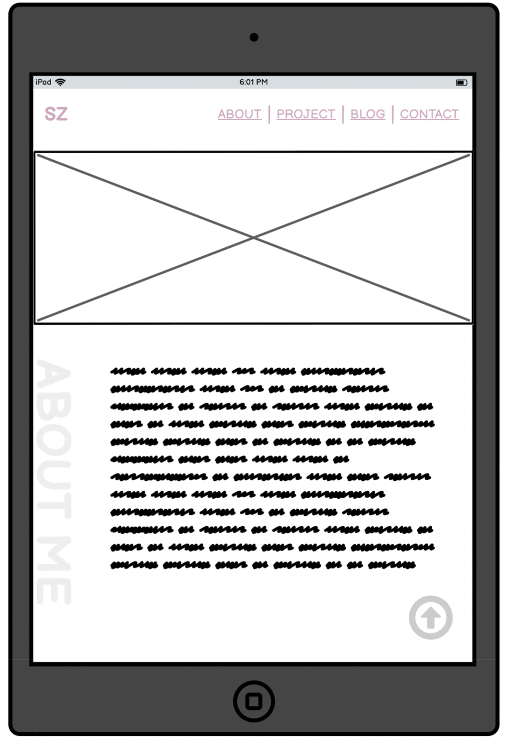
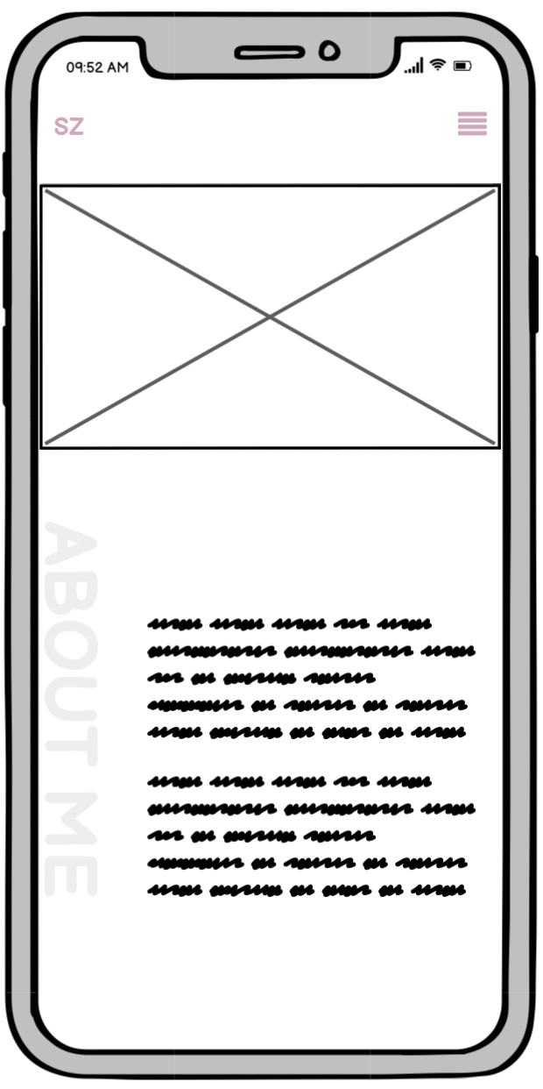
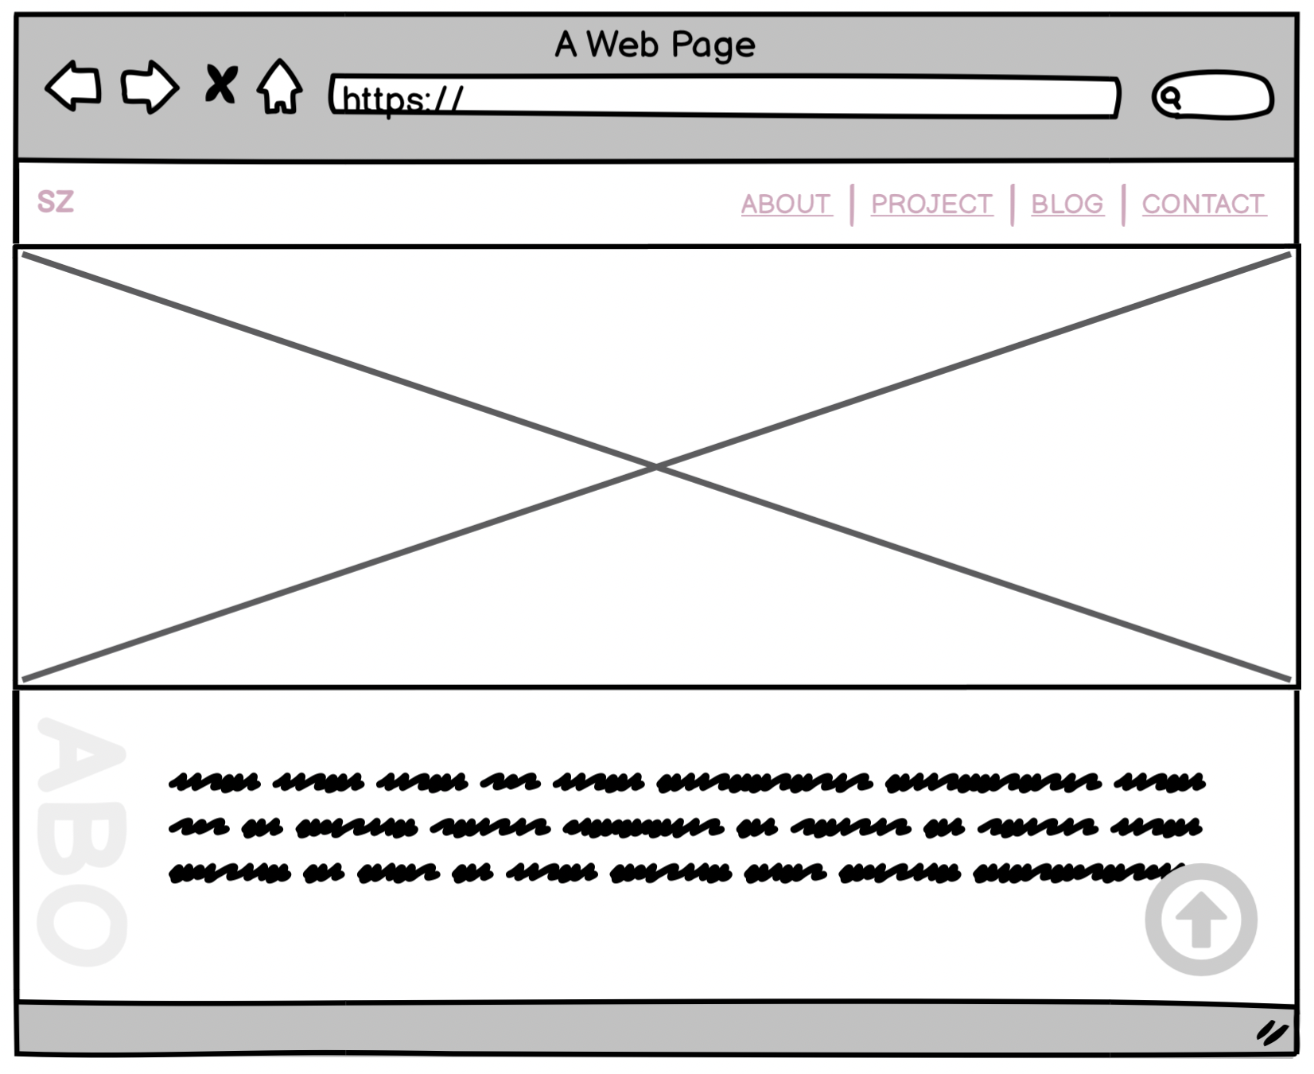
Logo Component
1. Navigation Bar Component and feature
Hamburger Menu Component
Navigation Component
Notes:
These are components that will be used in my website:
Firstly I would like to talk about Navigation bar component and feature
The navigation bar component is responsive, meaning it will adjust its size and behaviour based on the screen size
It is made up of several sub-components:
The logo that links back to the homepage
The navigation component that links to all other parts of the site. It consists of a horizontal list of links
When the screen size drops below 800px, the Navigation Component is replaced with a Hamburger Menu Component
The hamburger menu component displays links to the other parts of the site in a vertical list instead. This works better with smaller screen sizes

Slide 14
2. Two column Component used for
About me feature
Title
Text or another element
Notes:
Secondly, I would like to talk about the Two column component which I use for my about me feature
The Two column component has two parts
The first part is the title that shows users which section you are on. The title is rotated 90 degrees (text-orientation: sideways; ) as part of the site aesthetics
The second part is a space for Text or another element. In the example here, I’m using the space to describe my interest, skills, education and work history

Slide 15
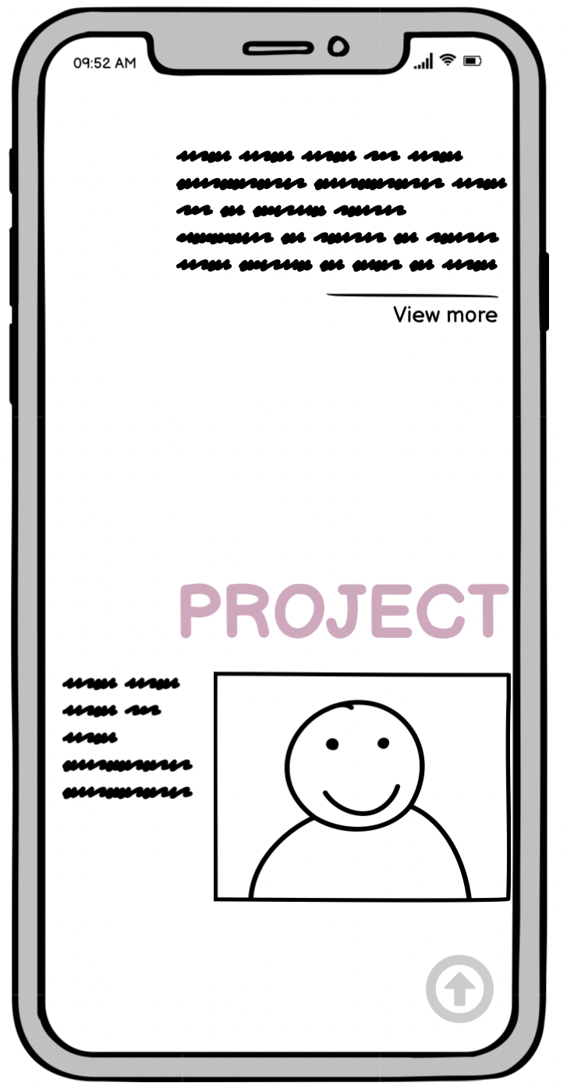
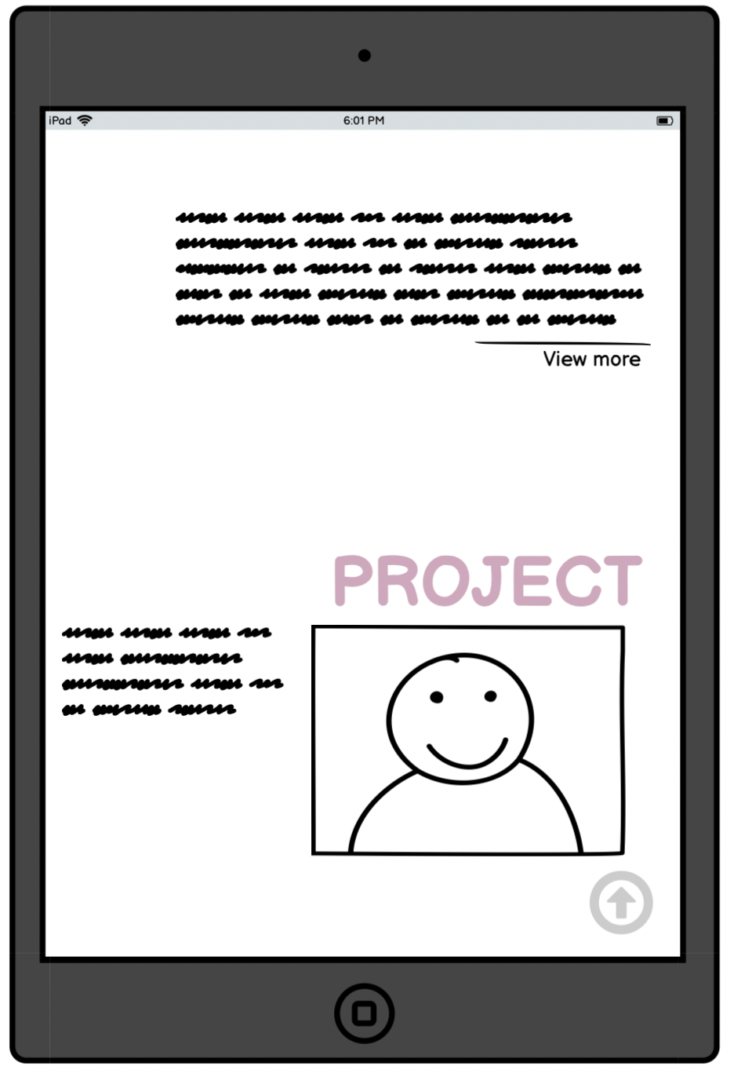
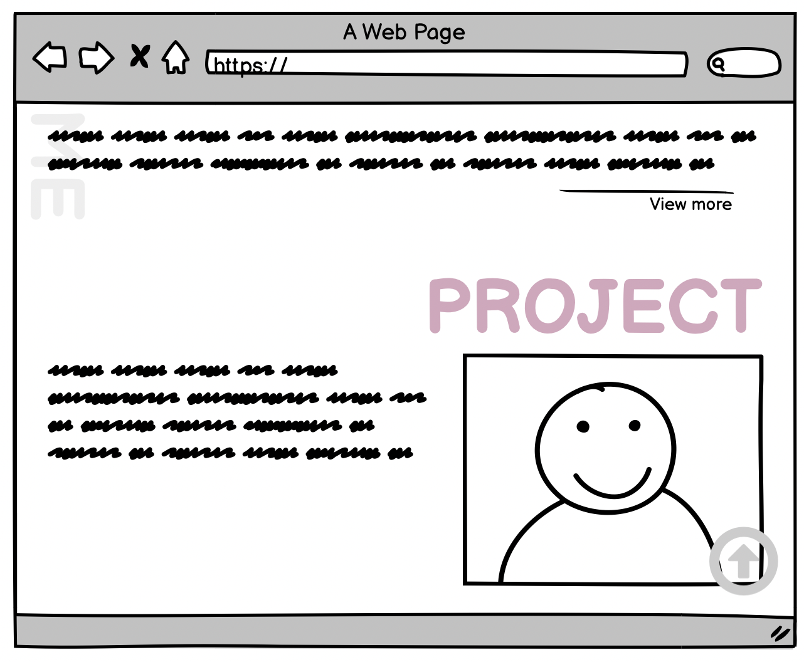
3. Text with Image component
used for project feature
Title
Image
Text
Notes:
The Text with Image component consists of three parts:
The title that shows which section we are on.
Some Text
And an image
In this example I’m using this component to show my latest project.
In the future I’d like to extend this to show multiple projects

Slide 16
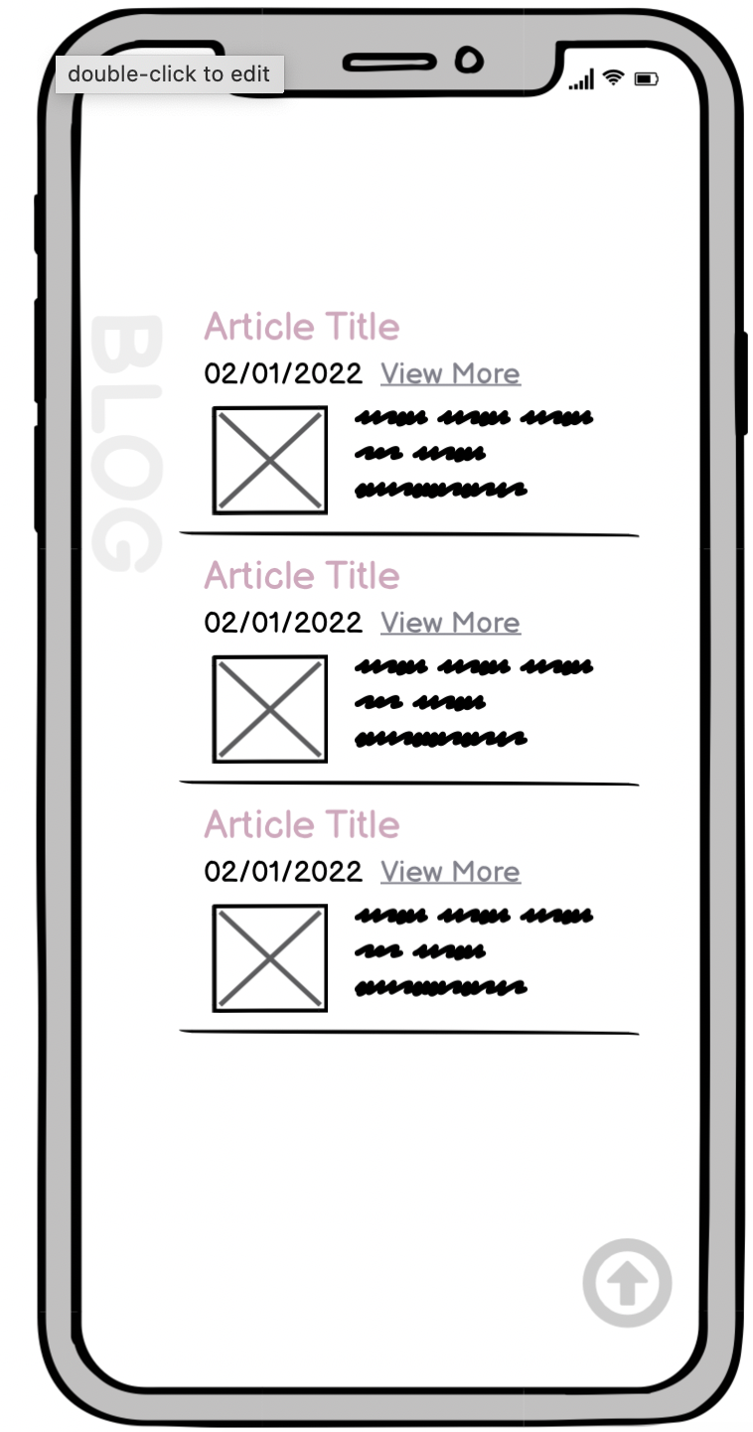
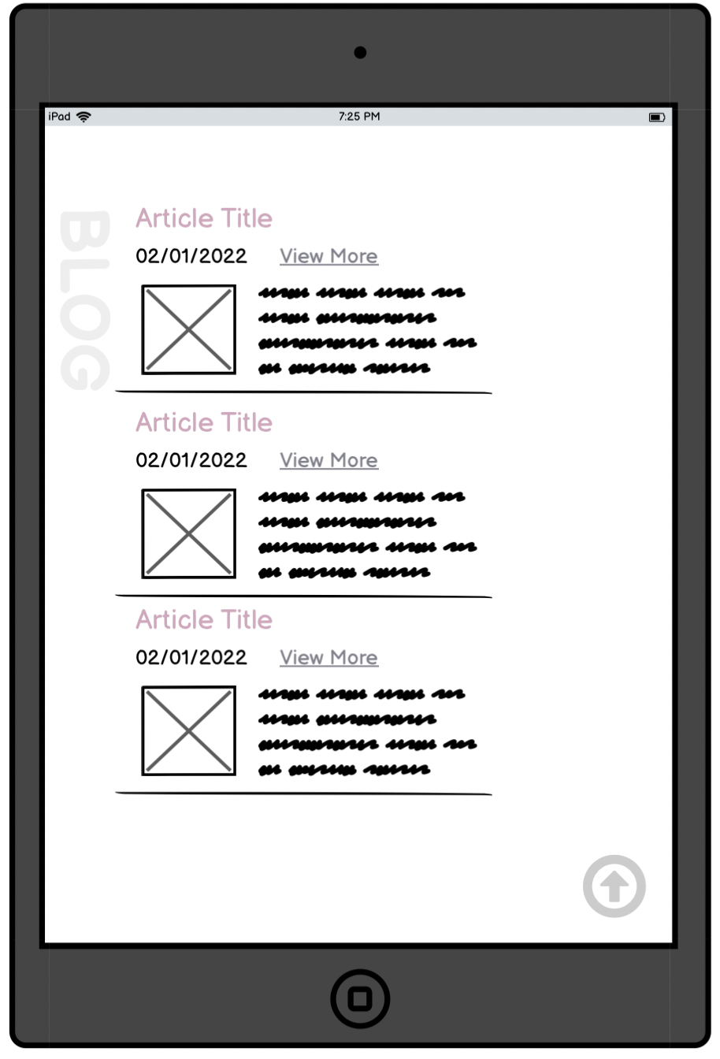
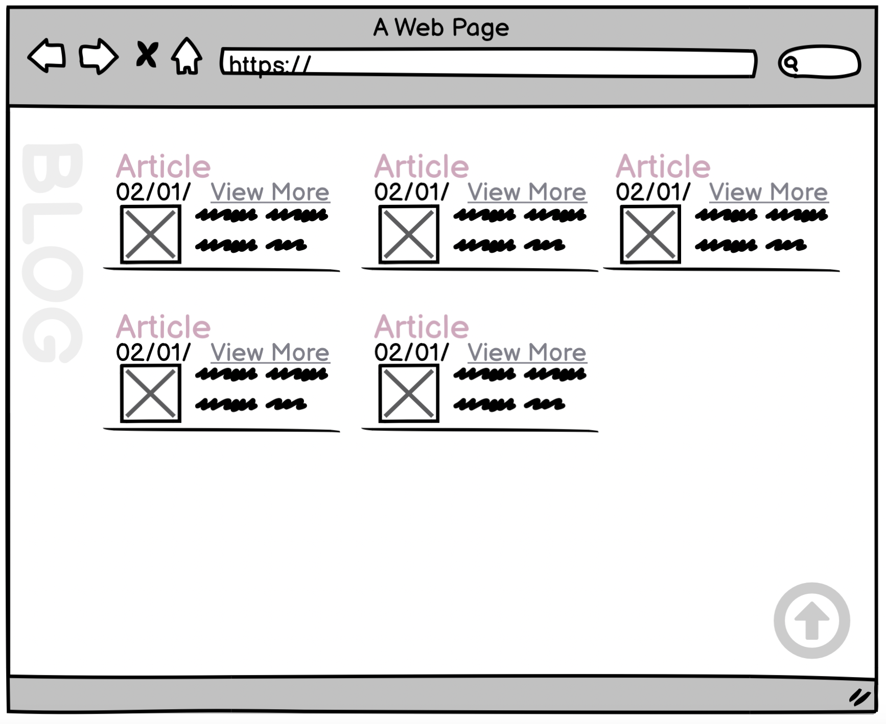
4. Blog Article Component used for blog feature
Article Title
View More
Date
Image
Abstract of the article
Notes:
Next, Blog Article Component which I am using for my blog feature
One feature of the blog article component is that it can be used inside other components.
The blog Article component is shown at the left of the screen, I reused it 5 times in my blog section.
The Blog Article Component has several parts:
The Article Title and View More that links to the Article page
The Article date
An image which catches the user’s attention and lets the user quickly understand what the article is about
And the abstract of the article which shows the first paragraph of the article.

Slide 17
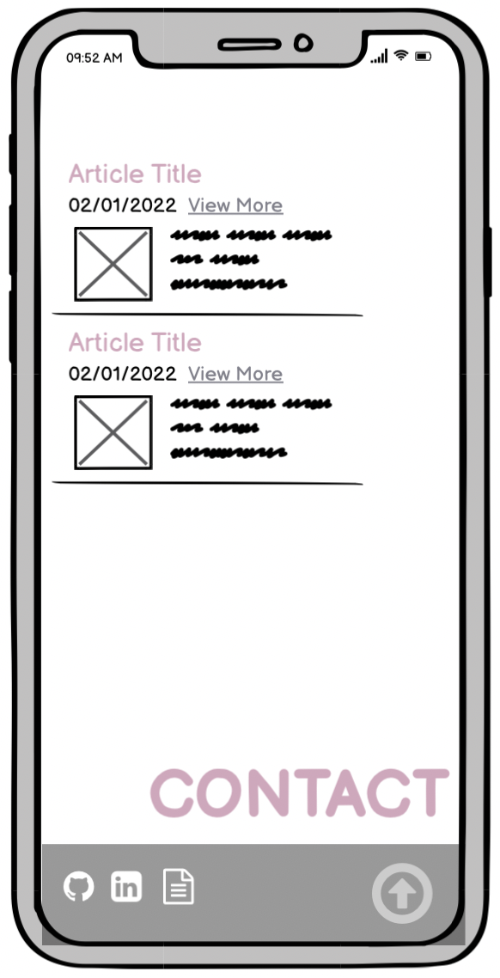
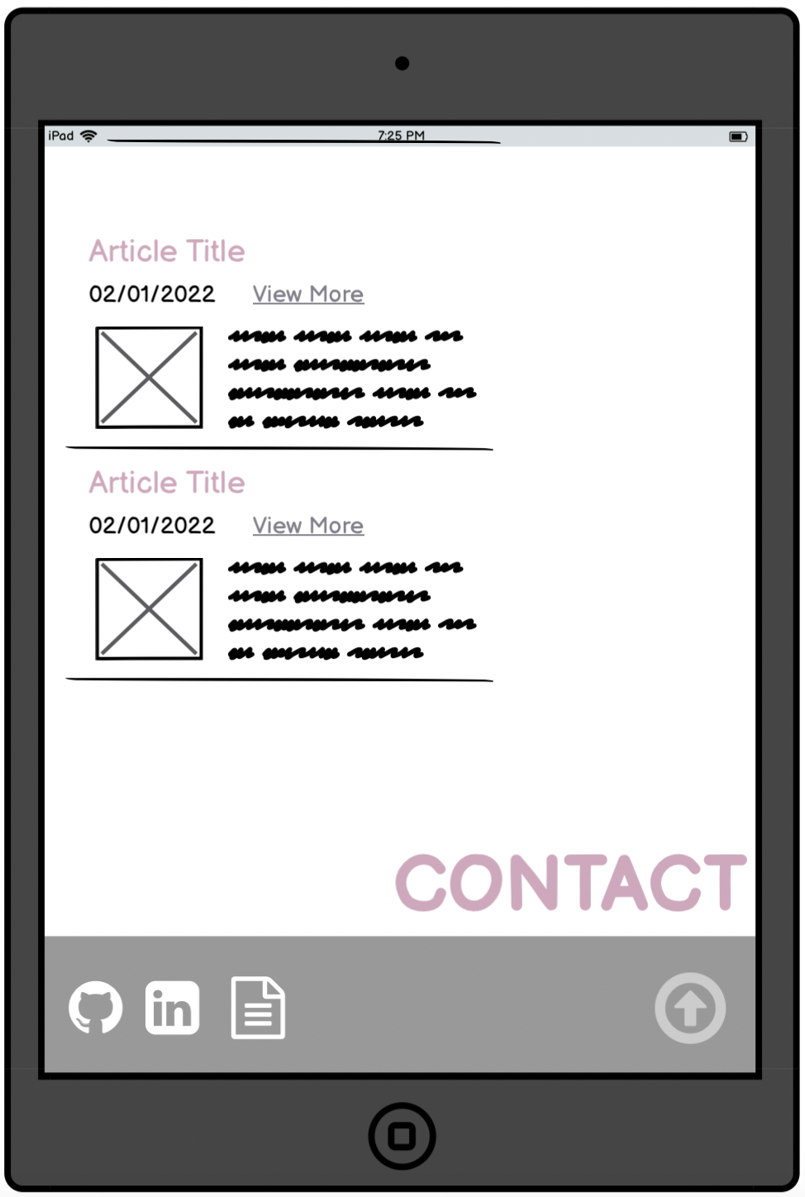
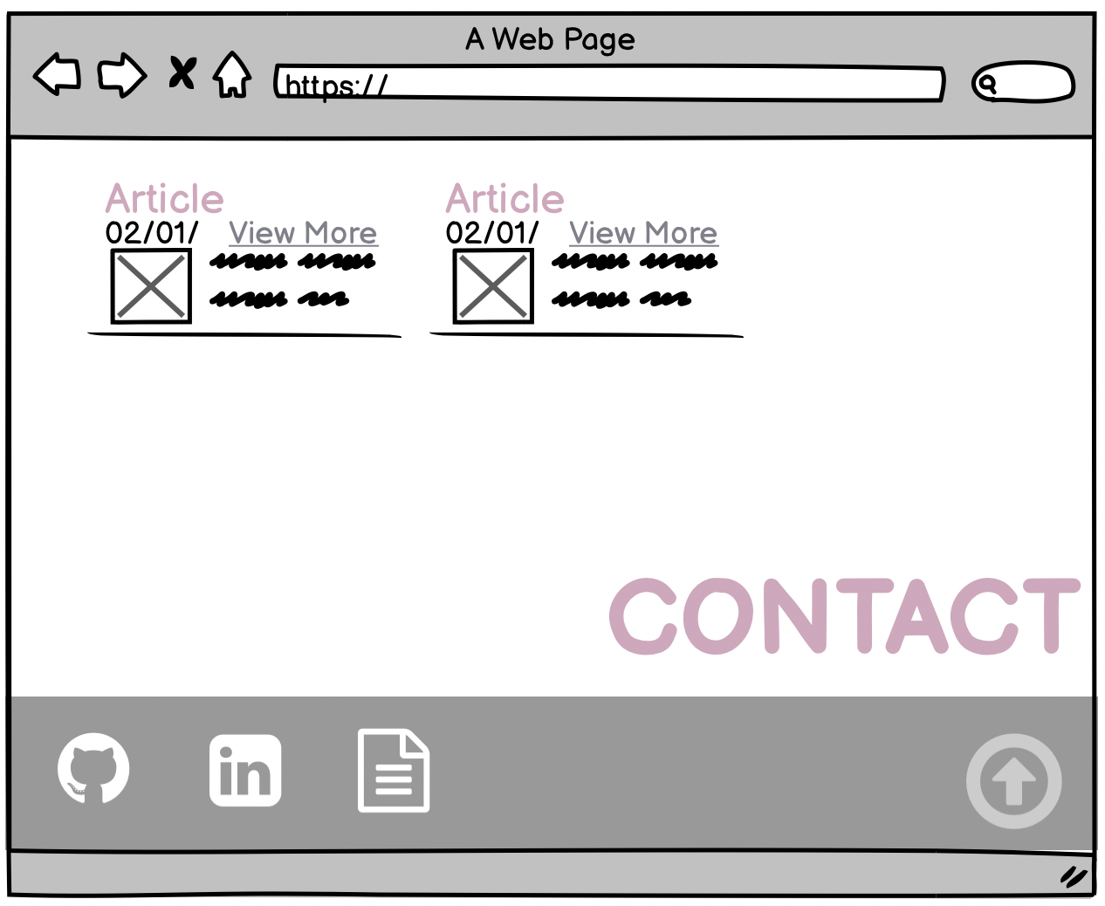
5. Footer Component used for my contact feature
Image
Perfectional Contact
title
Notes:
Next, I would like to talk about footer Component:
The footer component is always shown at the bottom of every page.
And it is always 100% width of the screen.
It is made up of several parts:
The first part is the title
The second part is the professional contact information
The last part the background image of the footer section.

Slide 18
6. Back-to-top Component
Back-to-top navigation
Notes:
This is the Back-to-top navigation component that takes users to the top of the page at any section.
It is fixed in the bottom right corner over the website and doesn’t scroll with the rest of the site. This makes it accessible at any point in the site.

Slide 19
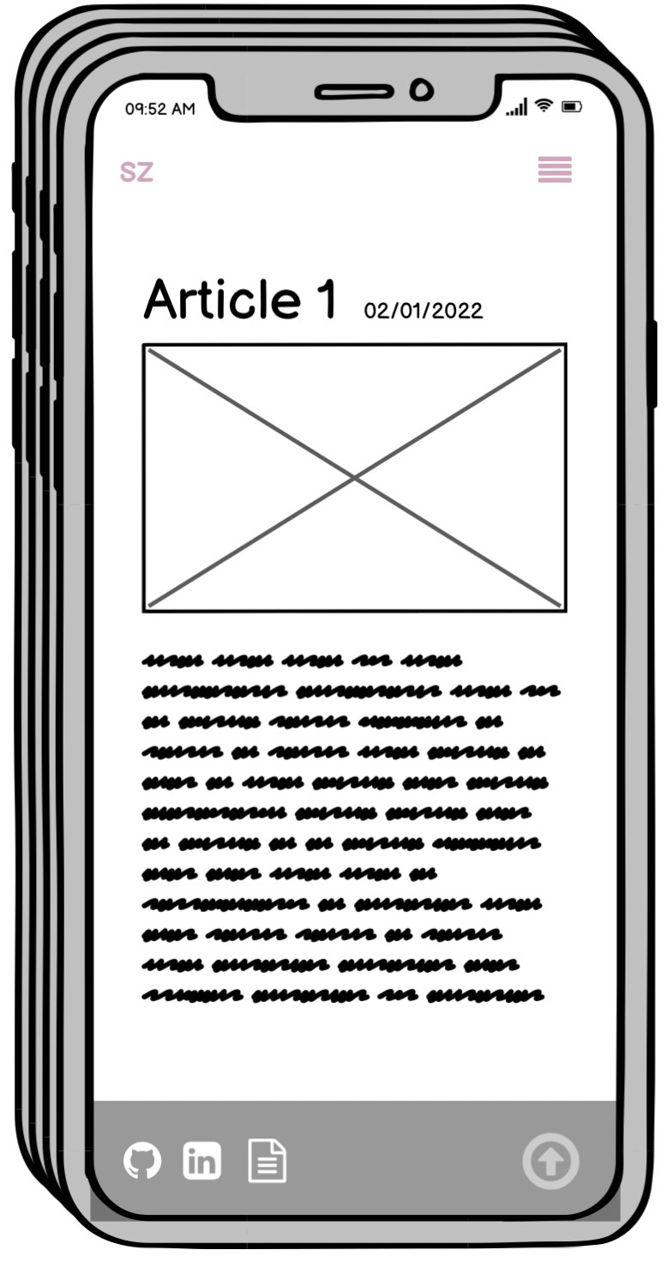
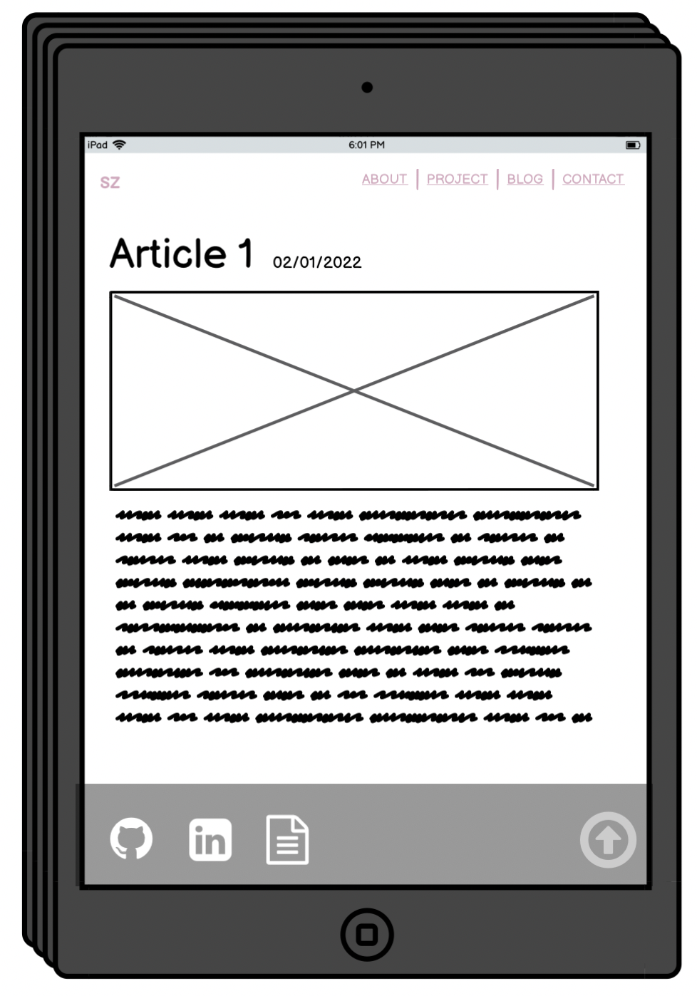
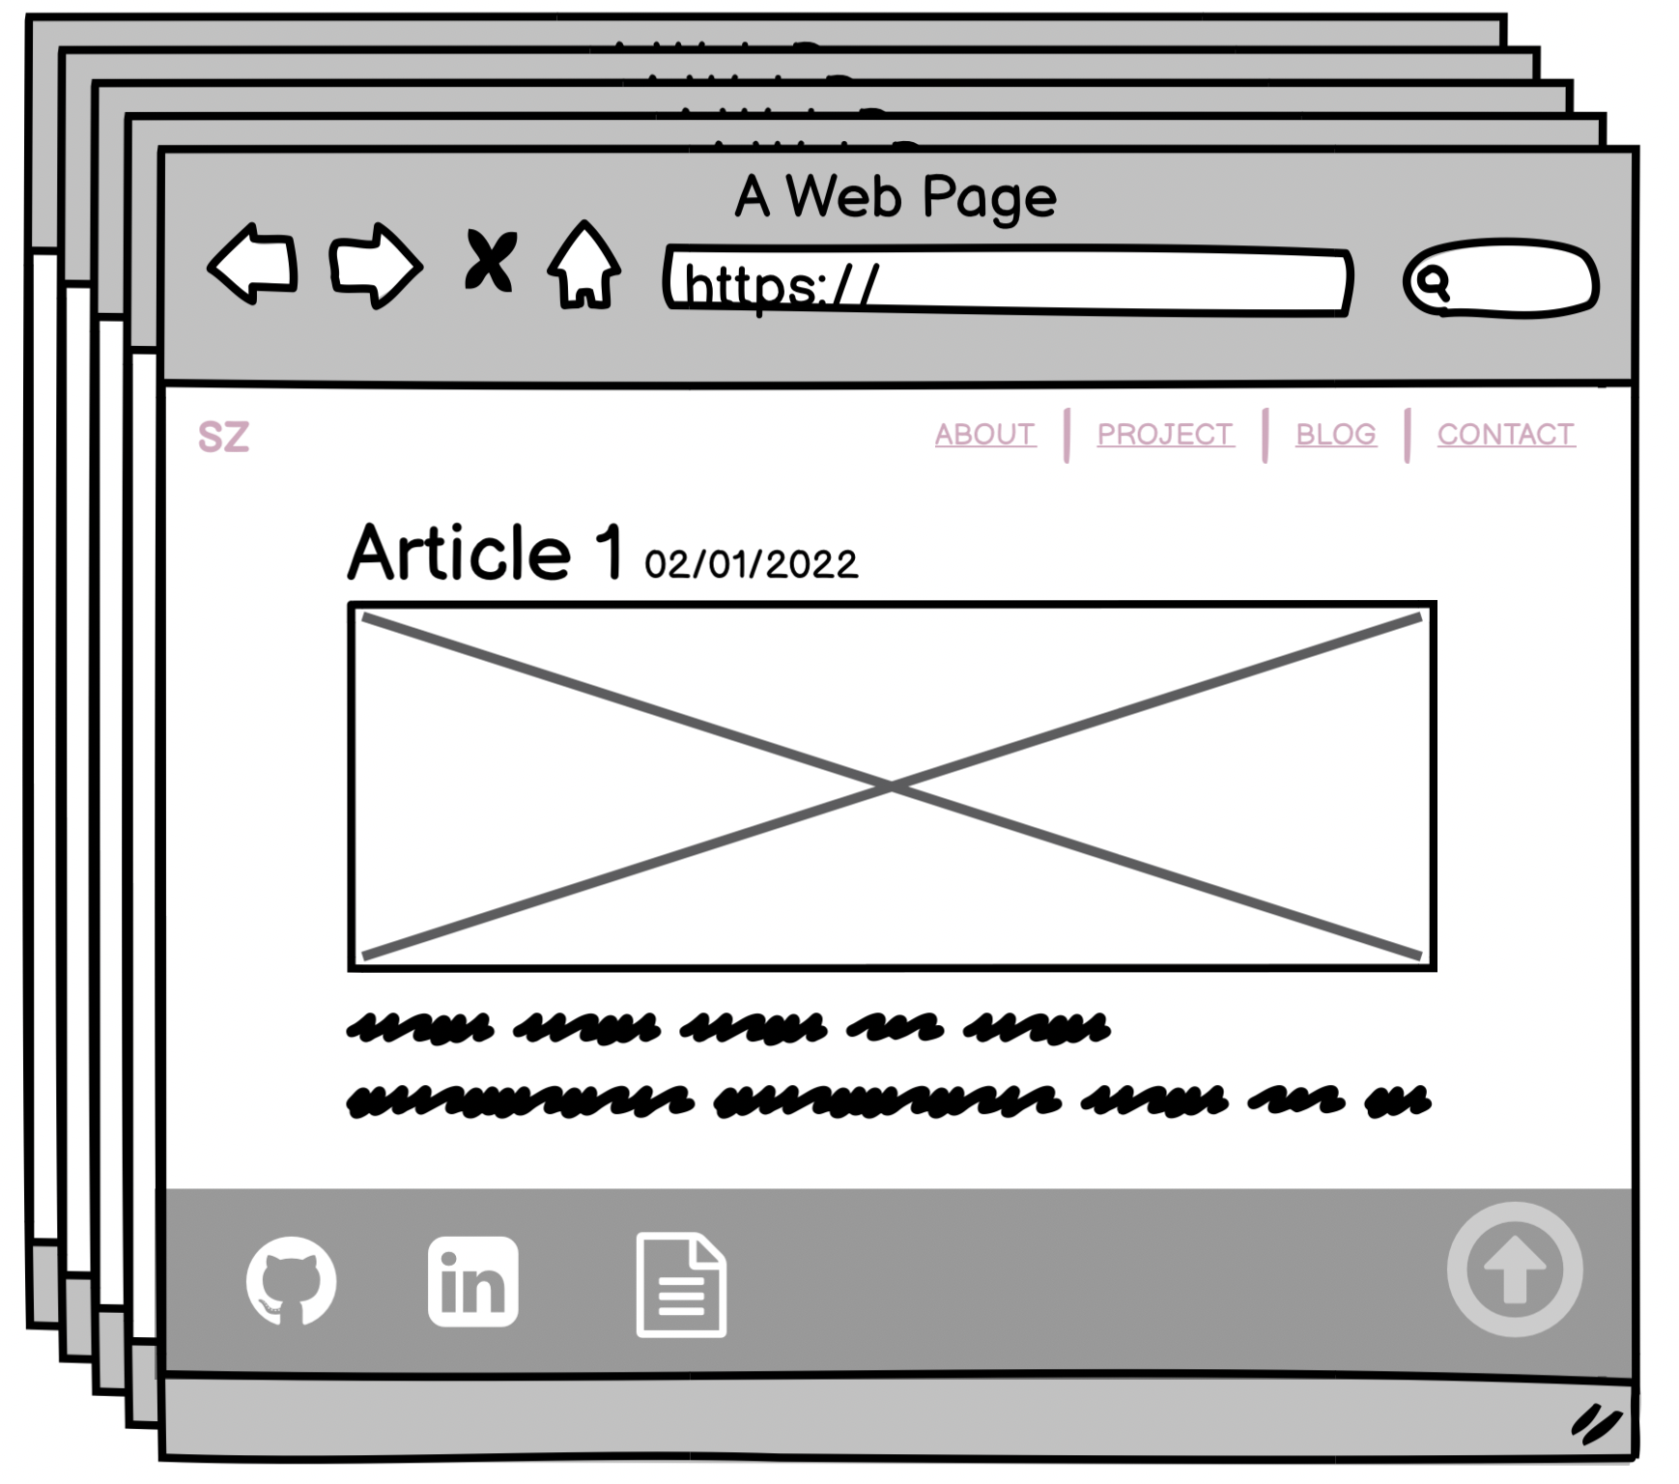
Title
Date
7. Article Component used for blog page feature
Image
Text
Notes:
The last is Article Component which I use for each of my separate blog article pages:
The Article component consists of four parts:
The title that shows the title of the article.
The date.
An image, that shows the relevant image of the article.
The text that shows the full article.

Slide 20
Audience Engagement
Notes:
Now let’s look at the Audience engagement

Slide 21
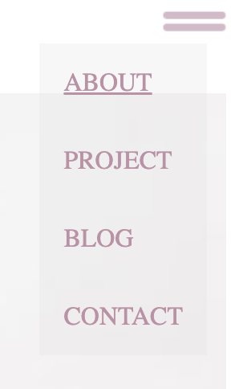


Audience Engagement with Navigation
Transparent background menu list for enhanced design style
Navigation Bar
When the width of browser under 800px will switch to hamburger menu
Hamburger Menu
The text shows underline when hovered over
Notes:
The navigation bar transforms into a hamburger navigation bar when the website is viewed on a mobile device,
The hamburger navigation bar makes it easy for users to jump to the corresponding section at any time when they are on a small screen.
The menu items are shown vertically to fit on a smaller screen.
The menu is designed with a transparent background for enhanced design style

Slide 22


Audience Engagement
Contact Icons
Back-to-top navigation
Takes the user back to the top of the page at any time in any section
Hover over the contact icon to zoom in and out which increases the interaction with the user
Notes:
Hover over the contact icon to zoom in and out and increase interaction with the user
I chose to use a Hover over zoom / scale up effect on the contact icons to draw the user’s attention and as an invitation for the user to interact
Back-to-top navigation can take the user back to the top of the page to find the nav bar at any area for improved convenience

Slide 23
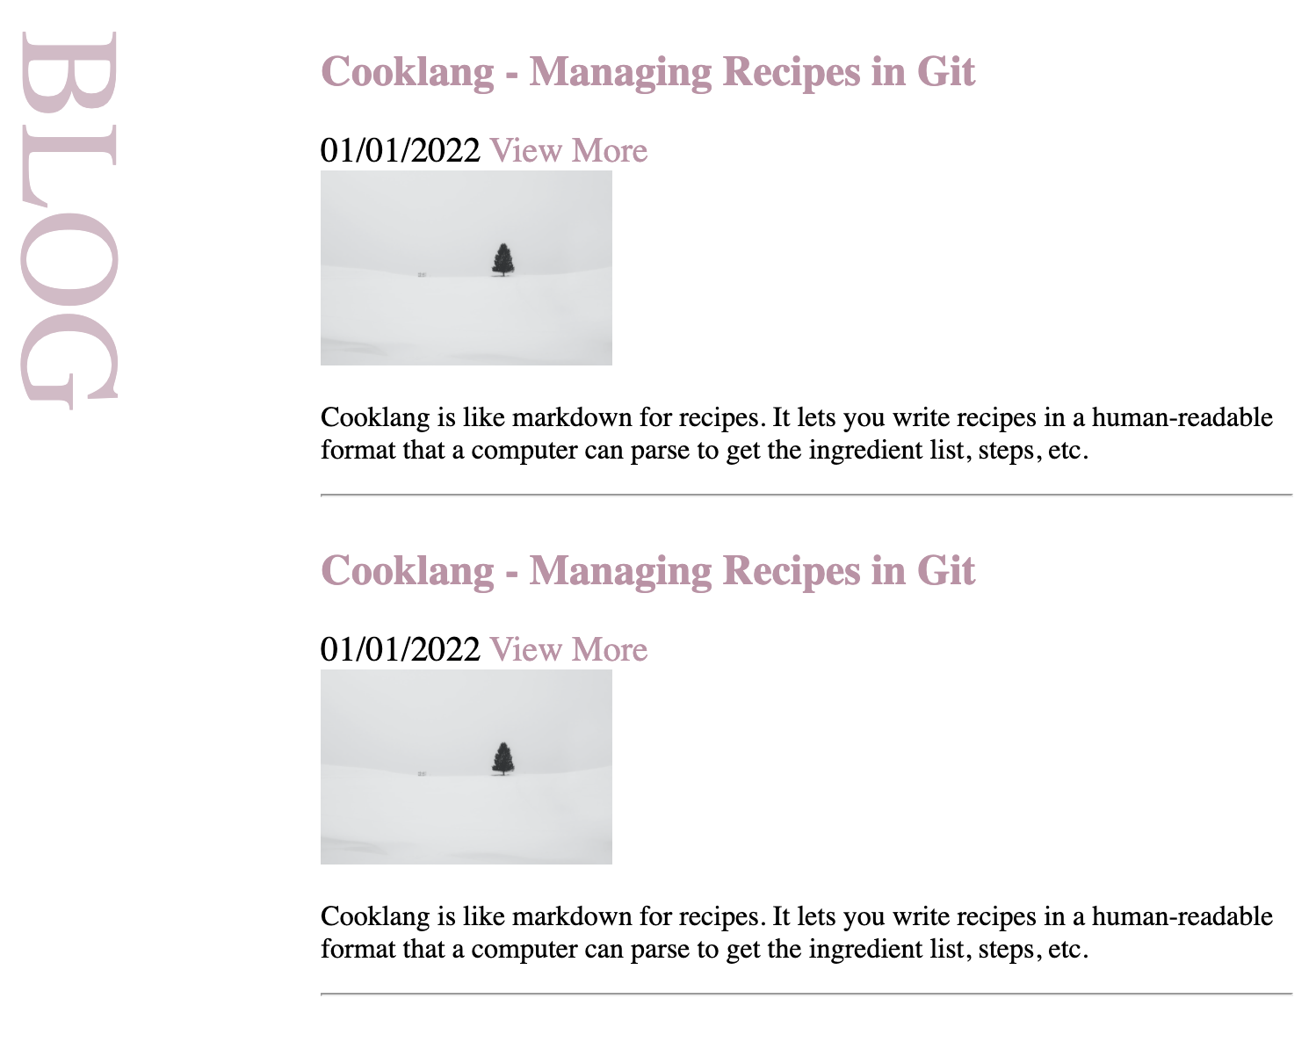
Audience Engagement
Hover over zoom / scale up effect on blog images to draw the user’s attention to the images
View more and title will link to the corresponding blog
Hover over will show underline as an invitation for the user the interact
Notes:
Hover over zoom / scale up effect on blog images to draw the user’s attention to the images, and as an invitation for the user to interact
View more and title will link to the corresponding blog, hover over will show underline for interacting with user

Slide 24
Development and build process
Notes:
Development and build process

Slide 25
Development / Build process
Challenges
Achieving the correct layout and alignment
Fragile CSS and unexpected impact of changes
Using JavaScript to create hamburger menu
Issues
Image animations overlapping text
Favourite parts
The back to top nav button brings users back to the top of the page
Responsive: When the screen size is below 800px, the text navigation bar will automatically become a hamburger menu
Animation of the contact-icons, images and titles
Notes:
I divided this into three parts:
The first part are the challenges I met when I built my website:
Achieving the correct layout and alignment:
(Understanding the correct CSS to use in order to translate the layout in my design to the website layout)
Fragile CSS and unexpected impact of changes
:( The CSS is quite quite fragile and changes can have unexpected impacts)
Using JavaScript to show hamburger menu
( was the first time I have used JavaScript and the learning curve was steep.)
The second part is the Issues:
Image animations overlapping text
The third part is my Favorite parts of the website:
The back to Top navbar
Is responsive and switches from navigation bar to hamburger menu
Animation of the contact-icons.
Images and Titles animation

Slide 26
Website overview (if time permits)
Notes:
This is my website overview and how it looks so far

Slide 27
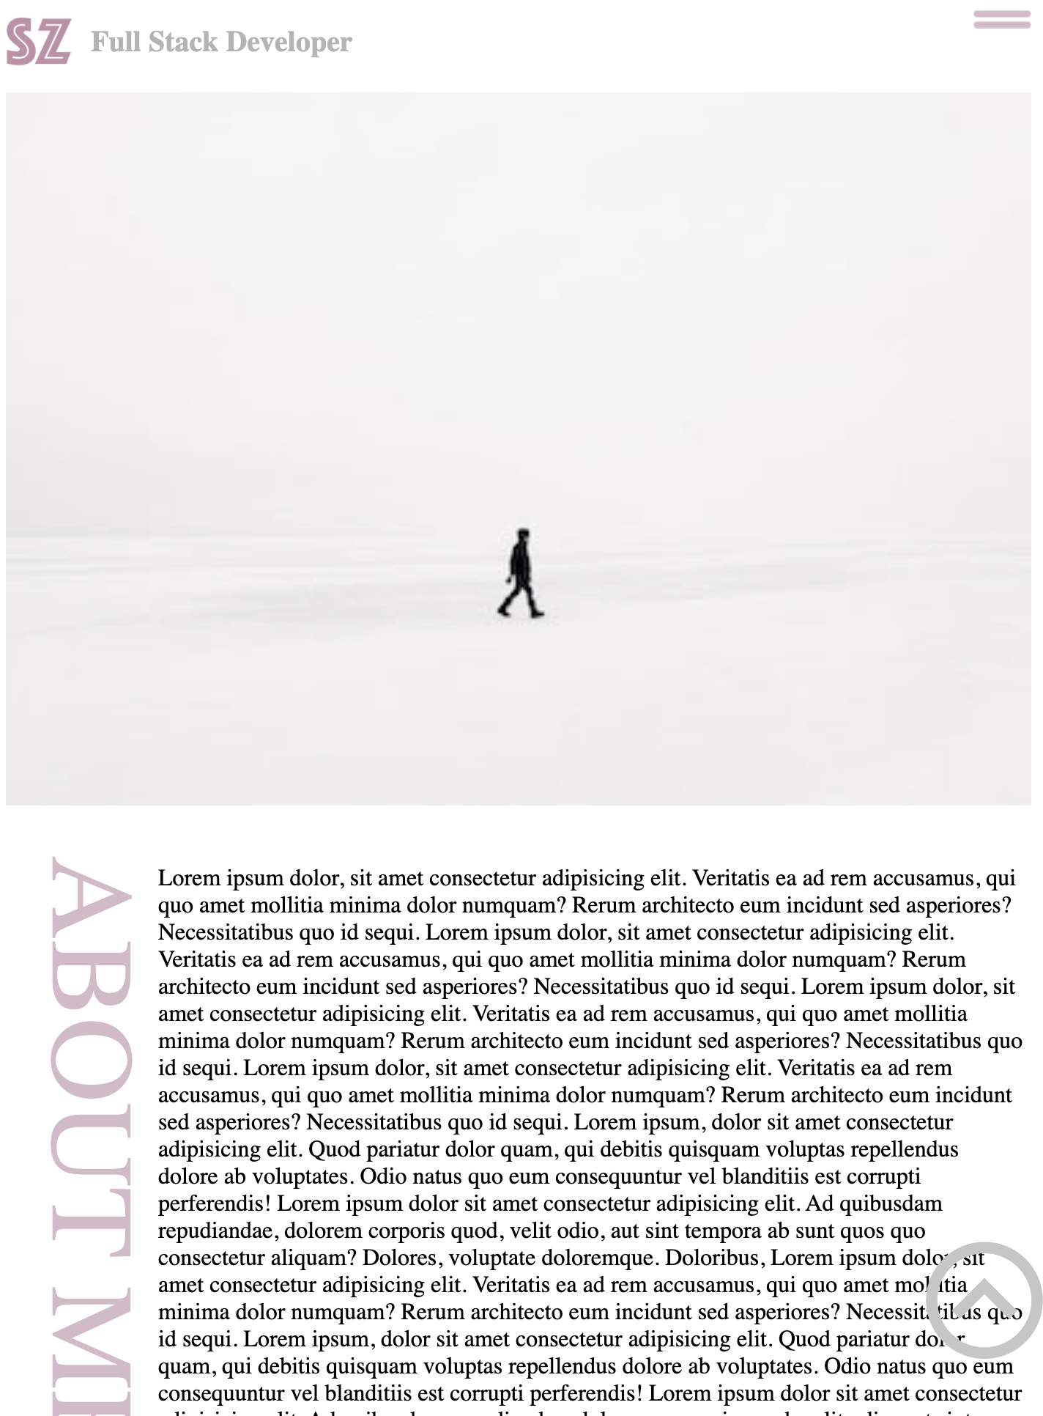
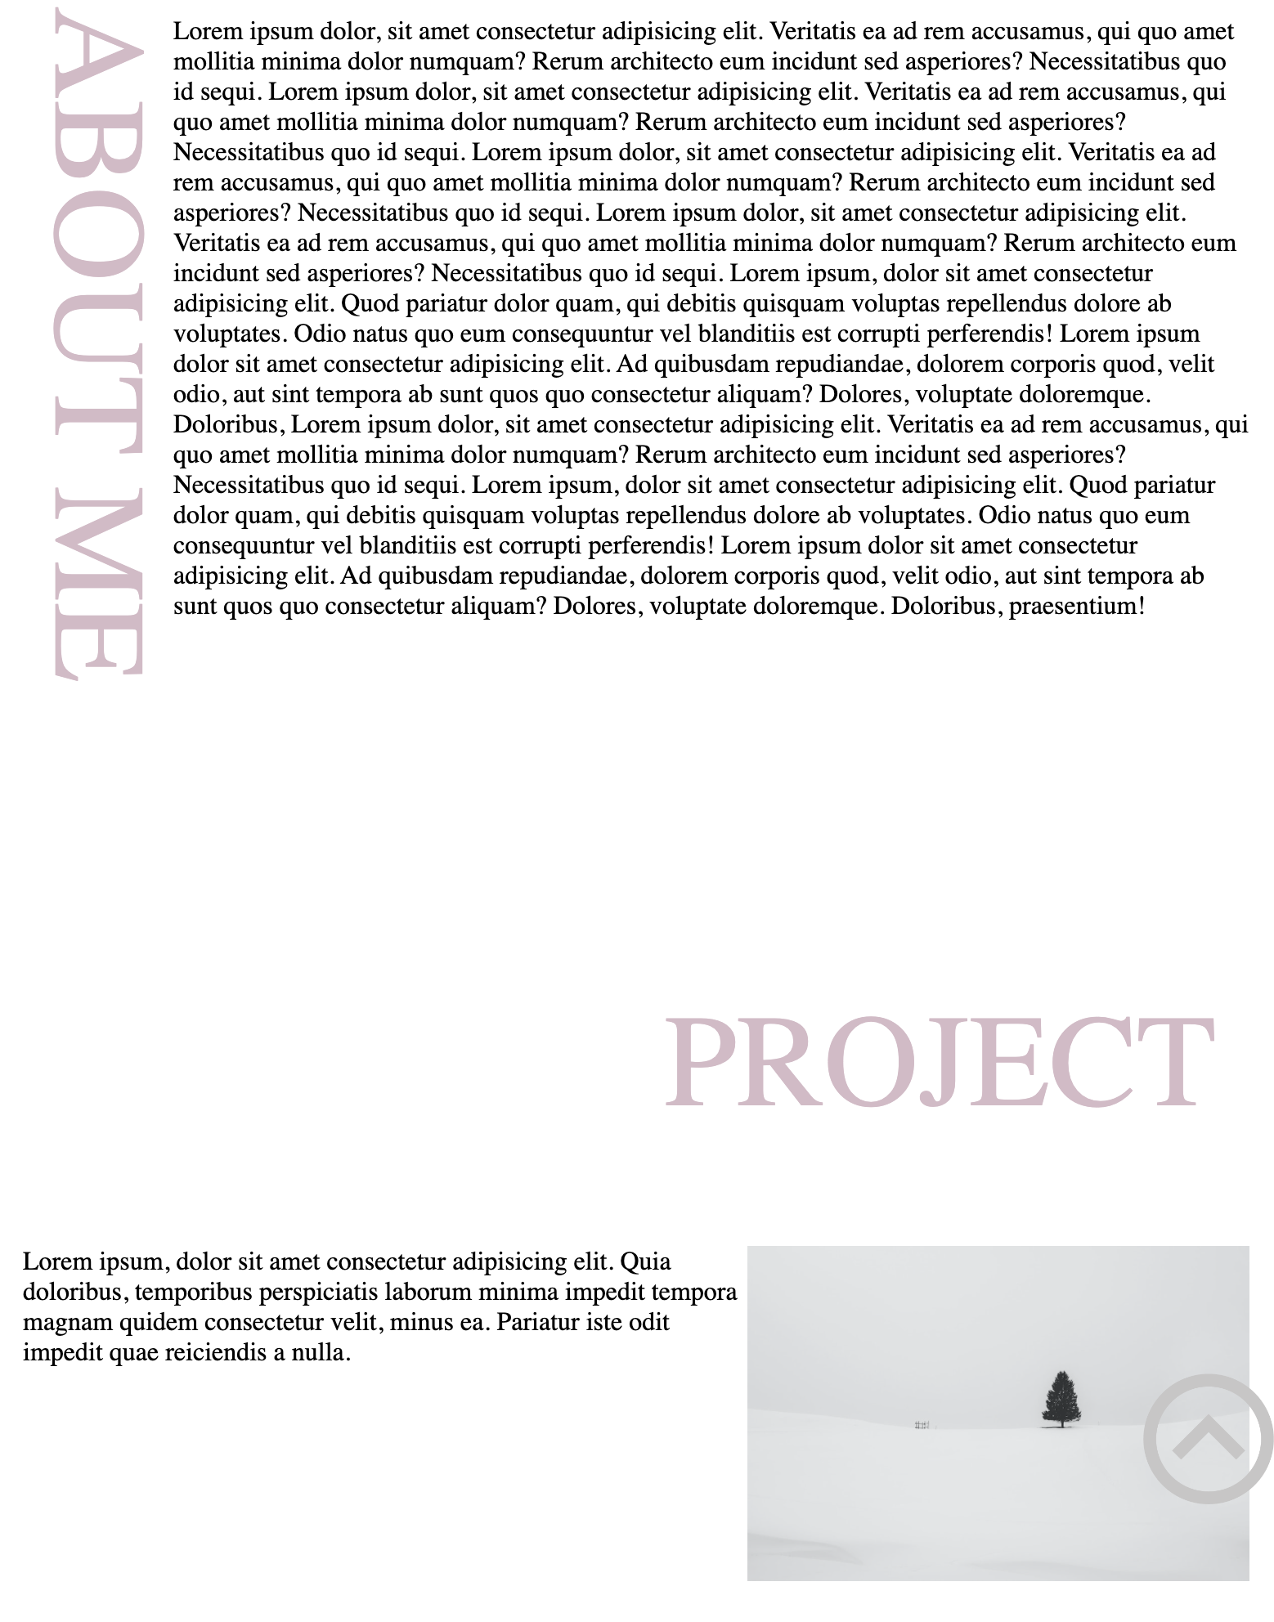
LOGO
Main Image
Title
About me
Back to top
Notes:
This is the about me and project section
On the top the page is the navigation bar
Underneath is the main image
On the about me section the title is on the left of the page
The project section title is vertical
In the bottom right of the corner is the back to top arrow

Slide 28
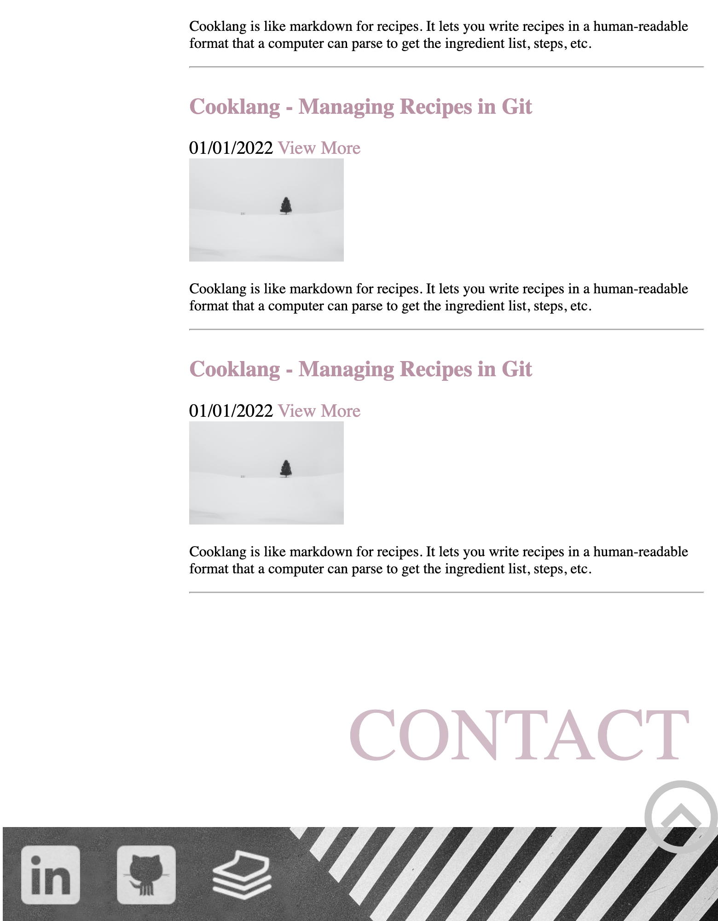
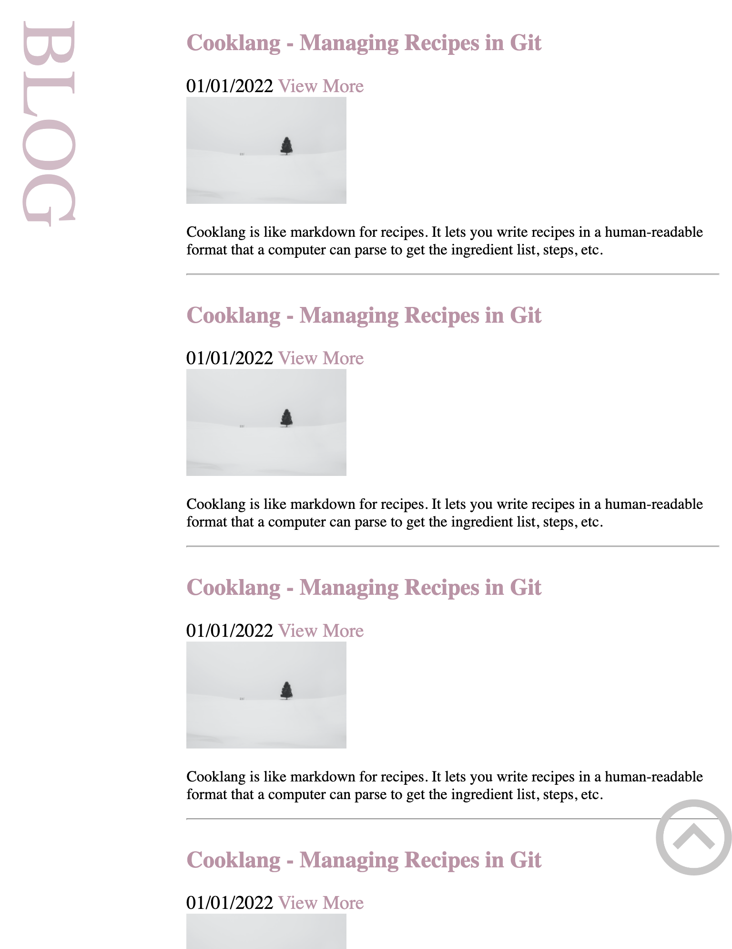
Title
Title
View more
Footer
Notes:
This is my blog section and contact section
On the blog section the title is on the left of the page,
The 5 blogs are on the right of the page
Clicking on the title of the blog or View More, will link to the corresponding blog
the Contact section is at the bottom of the homepage. There are personal contact links in the contact section

Slide 29
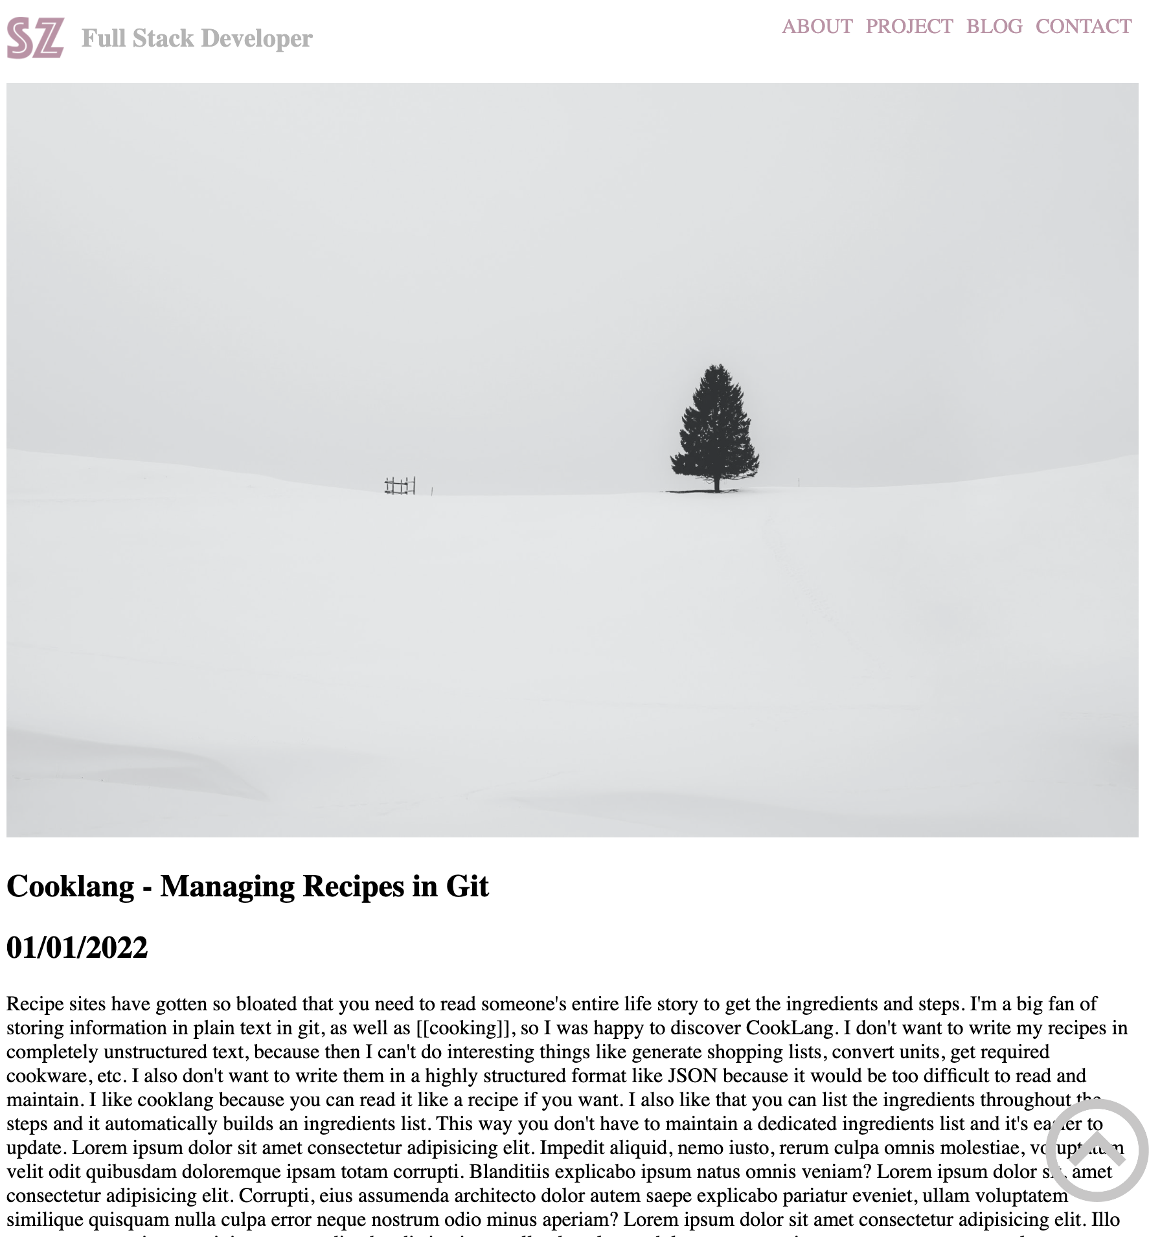
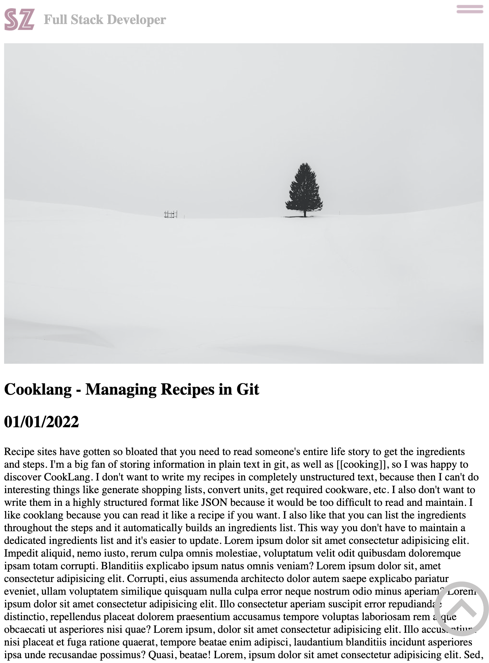

Navigation bar
Logo
Image
Title
Article
Footer
Notes:
This is the article page, included: navigation bar ,image article title ,date , full article and footer
Click on the logo to go back to the homepage
A user can navigate to different all sections through the navigation bar at the top of each article page
They can also click on the logo to go back to the homepage.
The article starts with an image and is followed by article title, date and the full text of the article
The footer is always shown at the bottom of the page.

Slide 30
Questions?

Slide 31
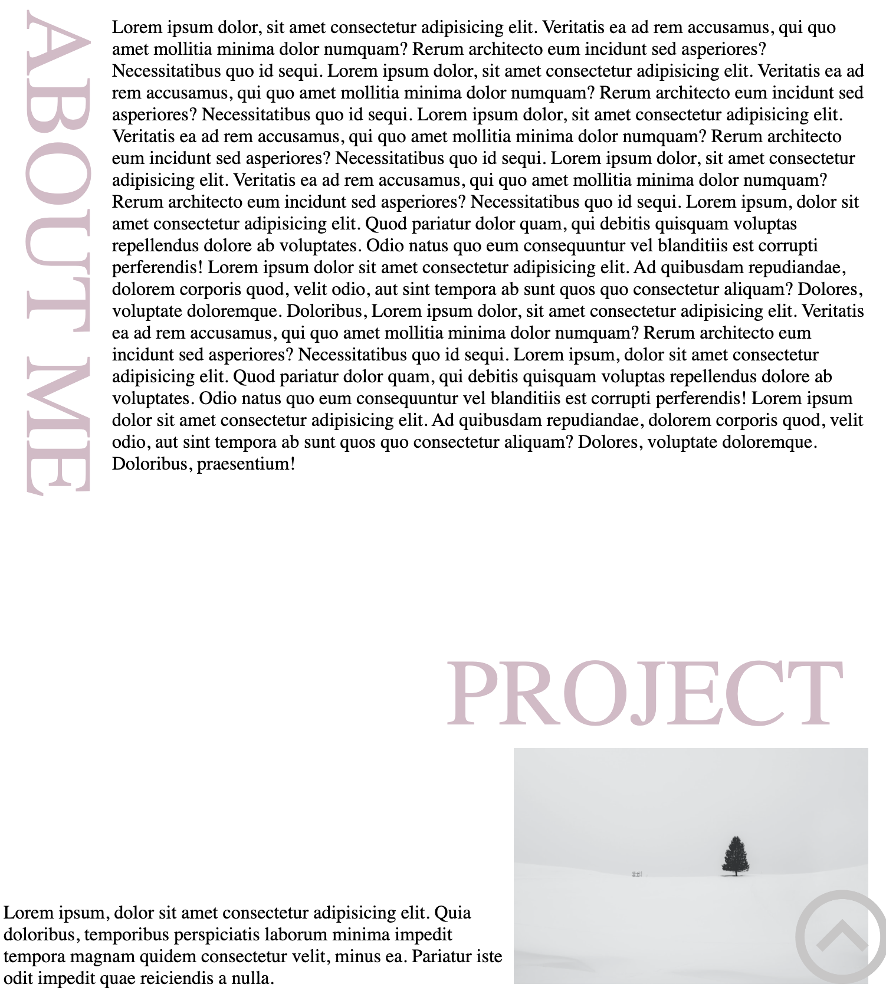
Audience Engagement
The title displays animations when browsing, draws the user's attention
The large heading separates each section, allowing users to quickly find the section of interest
Notes:
The title displays animations when browsing which draws the user’s attention to each section as they scroll through the site
The large heading separates each section, allowing users to quickly find the section of interest

